Slide 1

COSMETICS PRODUCT SEGMENTATION FOR THE LUXURY BRANDS
Group - 15
Guide Name :
Mr. G R. Srinivas
Asst. Prof
Date: 15-12-2023
M. Srinija | – 2211CS030103
N. Pravalika | – 2211CS030127
Srinethri Shinde | – 2211CS030153
V. Mamatha | – 2211CS030168

Slide 2
INTRODUCTION
Our project focuses on the "Luxury Cosmetics Product Segmentation Analysis." The cosmetic industry is evolving, and understanding consumer preferences is crucial for effective marketing strategies. Through the identification of key variables, the objective is to tailor marketing strategies and product offerings, optimizing the approach to address diverse preferences within the luxury cosmetics consumer base.
The main objectives are
Provide insights into the luxury cosmetics market segmentation.
Showcase the significance of our analysis in shaping targeted marketing approaches.
Demonstrate the impact of segmentation on product development and consumer engagement.

Slide 3
Problem Statement
The luxury cosmetics industry encounters difficulties in addressing the diverse needs of consumers effectively. The traditional one-size-fits-all approach falls short in catering to the evolving expectations of a sophisticated and varied consumer base.
This problem holds immense significance as it directly impacts the industry's ability to stay competitive and resonate with the discerning tastes of luxury cosmetics consumers.
Highlight the dynamics shaping the luxury cosmetics market, such as the influence of trends, changing consumer demographics, and the competitive landscape.
Examine changing preferences, emphasizing sustainability, inclusivity, and personalized experiences to reach cosumer expectations and highlight how the identified problem affects sales, brand loyalty, and market positioning.

Slide 4
METHODOLOGY
Approach:
Adopted a holistic methodology to tackle the complexities of segmenting the luxury cosmetics market.
Data Collection:
Executed a dual-pronged data collection strategy, involving primary sources such as surveys and interviews, supplemented by secondary data mining from industry reports and studies.
Variable Selection:
Carefully selected and evaluated variables encompassing product features, demographics, lifestyle, and consumer behavior, ensuring their strategic relevance and distinctiveness.
Data Analysis:
Employed cutting-edge data analysis techniques to uncover hidden patterns, trends, and correlations within the collected data, laying the groundwork for robust segmentation.
Segmentation Bases:
Established clear criteria for segmenting consumers, crafting detailed profiles for each segment based on the identified variables, resulting in distinct and meaningful categories.
Validation Process:
Rigorous testing procedures were implemented to validate the stability and effectiveness of the segmentation results, ensuring their practical applicability.

Slide 5
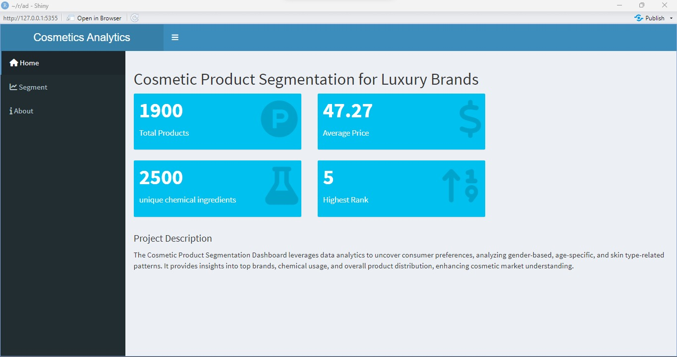
RESULTS
Home Page:The Cosmetic Product Segmentation Dashboard represents a pioneering
effort in decoding the multifaceted landscape of the cosmetic industry, where diversity, innovation, and consumer preferences intertwine.

Slide 6
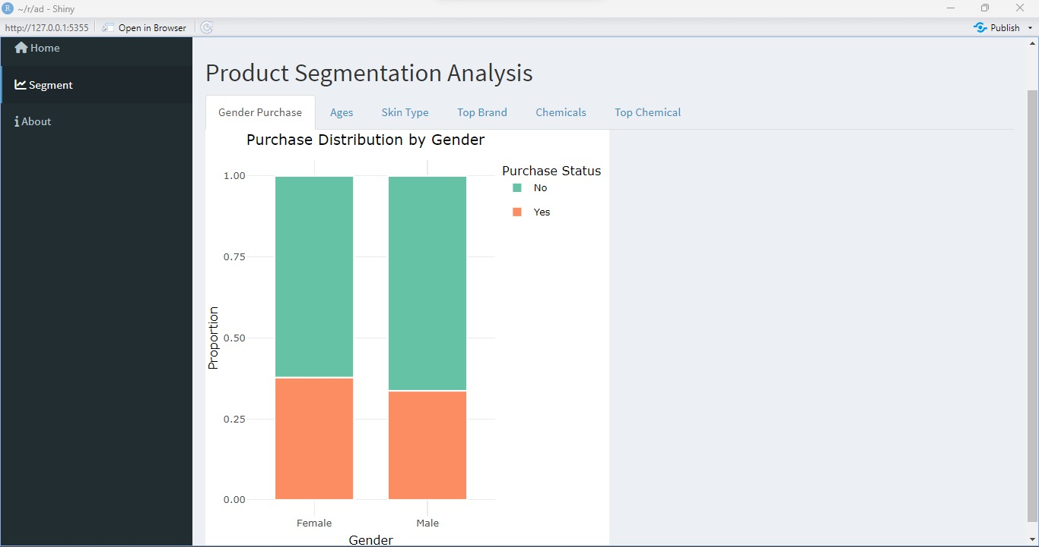
Gender Purchase Analysis:
The "Gender Purchase" graph presents a visual exploration of purchasing behavior across different genders. This dynamic plot allows stakeholders to discern patterns in buying preferences, facilitating targeted marketing strategies.

Slide 7
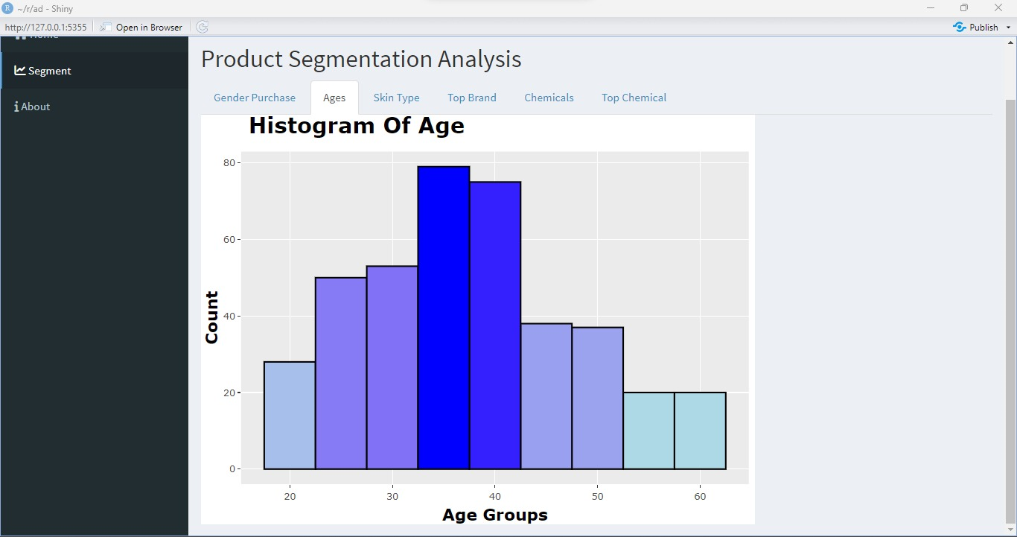
Ages Distribution:
The "Ages Distribution" graph provides a comprehensive view of age demographics in the cosmetic consumer base. This visual representation aids in identifying the age groups most engaged with cosmetic products.

Slide 8
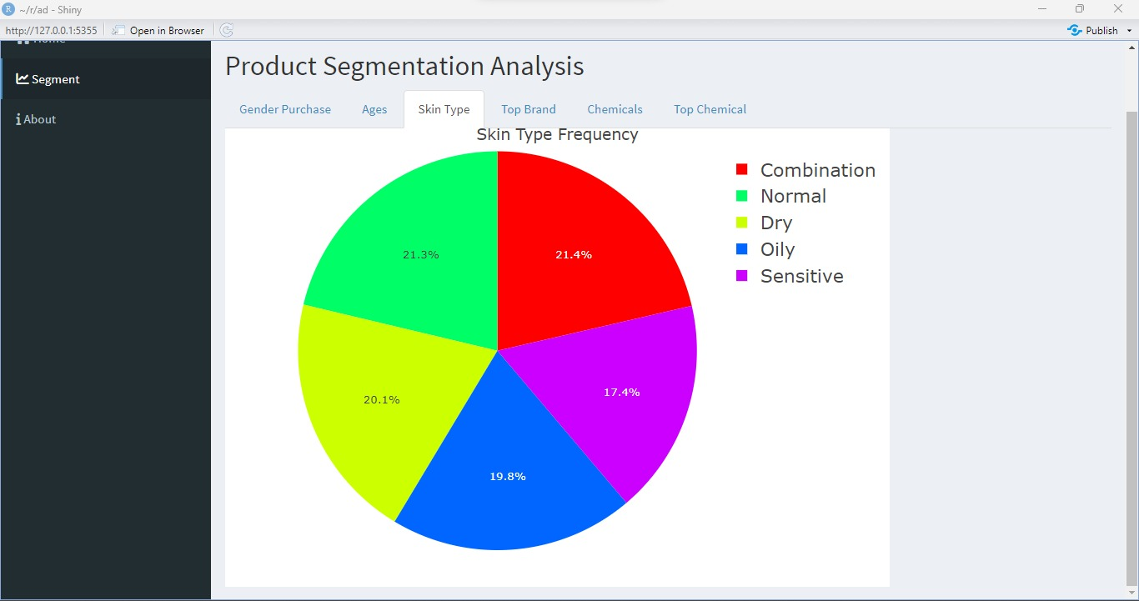
Skin Type Distribution:
Analyzing the "Skin Type Distribution" graph unveils valuable insights into the prevalence of different skin types among consumers. This knowledge is pivotal for formulating products that cater to specific skin needs.

Slide 9
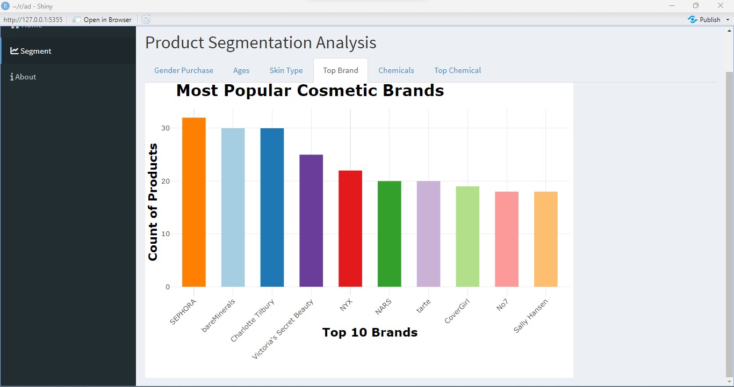
Top Brand Analysis:
The "Top Brand" graph highlights the most popular cosmetic brands based on frequency. This information is crucial for brand positioning, partnership opportunities, and marketing collaborations.

Slide 10
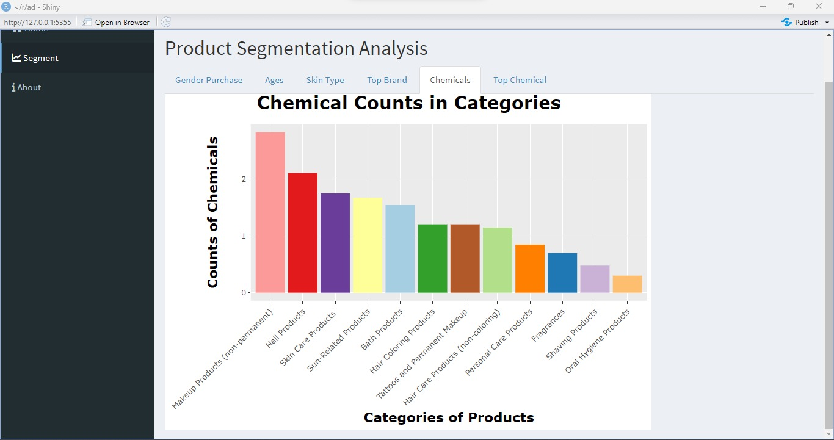
Chemicals Counts in Products:
The "Chemicals Counts" graph delves into the chemical compositions of cosmetic products. This detailed analysis aids in understanding the diversity and complexity of product formulations.

Slide 11
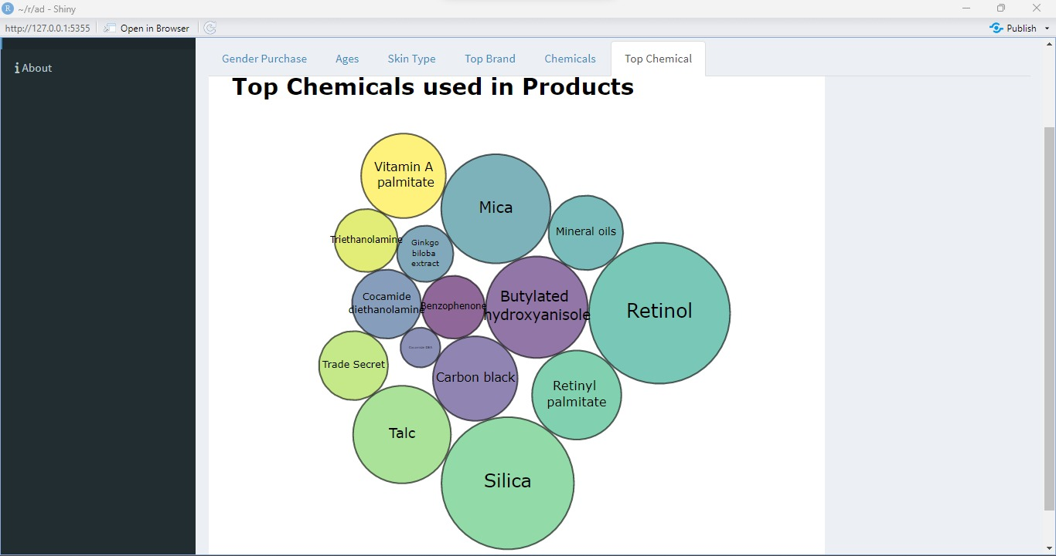
Top Chemicals Analysis:
Exploring the "Top Chemicals" graph sheds light on the prevalence of specific chemicals in cosmetic products. This knowledge is pivotal for regulatory compliance, quality control, and addressing consumer concerns.

Slide 12
Conclusion
Segmentation helps in identifying specific consumer groups within the luxury segment, such as age demographics, income brackets, lifestyle preferences, and cultural influences.
Segmentation allows luxury brands to position their products effectively in the market.
It aids in developing unique marketing strategies and campaigns that resonate with each segment's values, aspirations, and perceptions of luxury.
Luxury brands can elevate the customer experience by providing personalized services, exclusive events, and loyalty programs tailored to each segment's preferences.
Effective segmentation in the luxury cosmetics market can provide a competitive edge by establishing a deeper connection with consumers.

Slide 13
References:
Cosmetic products, https://www.kaggle.com/datasets/kingabzpro/cosmetics-datasets
Chemicals in Cosmetic dataset, https://github.com/suchayarj/WhatsOnYourFace
https://github.com/Duongvinh227/machine_learning/blob/main/dicisionTree/decision_tree.csv, product purchase
Shinydashboard, https://rstudio.github.io/shinydashboard/
Ggplot2 tutorial, https://ggplot2-book.org/introduction.html

Slide 14

THANK YOU

